Slide 1
Spring Cloud Config

Slide 2
Objectives
Introduce Spring Cloud Config
Understand the requirements for connecting and mapping the documents
After completing this lesson, you should be able to do the following
Notes:
A long section covering all the basics of using REST with Spring. Covers both Server-side REST using spring MVC and client-side using the RestTemplate.

Slide 3
Spring Cloud Config
Spring Cloud Config provides server and client-side support for externalized configuration in a distributed system.
With the Config Server you have a central place to manage external properties for applications across all environments.
The concepts on both client and server map identically to the Spring Environment and PropertySource abstractions, so they fit very well with Spring applications, but can be used with any application running in any language.

Slide 4
Spring Cloud Config
As an application moves through the deployment pipeline from dev to test and into production you can manage the configuration between those environments and be certain that applications have everything they need to run when they migrate.
The default implementation of the server storage backend uses git so it easily supports labelled versions of configuration environments, as well as being accessible to a wide range of tooling for managing the content.
It is easy to add alternative implementations and plug them in with Spring configuration.

Slide 5
Spring Cloud Config Features
Spring Cloud Config Server features:
HTTP, resource-based API for external configuration (name-value pairs, or equivalent YAML content)
Encrypt and decrypt property values (symmetric or asymmetric)
Embeddable easily in a Spring Boot application using @EnableConfigServer
Config Client features (for Spring applications):
Bind to the Config Server and initialize Spring Environment with remote property sources
Encrypt and decrypt property values (symmetric or asymmetric)

Slide 6
Spring Cloud Config – why configuration management is important
Spring Cloud applications, especially those built on microservices architecture, rely heavily on configuration management for a number of reasons:
Centralized Configuration
Environmental Differences
Dynamic Updates
Version Control
Microservice Isolation
Notes:
Spring Cloud applications, especially those built on microservices architecture, rely heavily on configuration management for a number of reasons:
Centralized Configuration: Spring Cloud Config offers a central Config Server to store and manage configuration for all your applications across environments. This eliminates the need to manage configuration files within individual services, promoting consistency and reducing errors.
Environmental Differences: Different environments (development, testing, production) often require unique configurations. Configuration management allows you to define and manage these variations centrally, ensuring applications run smoothly in each environment.
Dynamic Updates: Spring Cloud Config enables dynamic updates to configurations without restarting services. This is particularly useful when making quick changes or bug fixes.
Version Control: By storing configurations in a version control system (like Git, the default option in Spring Cloud Config), you can track changes, revert to previous versions if necessary, and maintain a history of your configuration.
Microservice Isolation: In a microservices architecture, each service should ideally have its own configuration. Configuration management prevents conflicts and ensures each service runs with the appropriate settings.

Slide 7
Challenges of Configuration management in microservices
Even though configuration management is crucial for microservices, it comes with its own set of challenges:
Increased Complexity
Versioning and Consistency
Security Concerns
Secrecy Management
Distributed System Issues
Notes:
Even though configuration management is crucial for microservices, it comes with its own set of challenges:
Increased Complexity: Managing configurations for numerous independent services can be complex compared to a monolithic application. Tools and processes need to be established to handle this distributed nature.
Versioning and Consistency: Ensuring all microservices use the correct version of configuration data across different environments becomes a challenge. Careful version control and deployment strategies are essential.
Security Concerns: Centrally storing sensitive configuration data creates a security risk. Measures like access control and encryption are necessary to safeguard this information.
Secrecy Management: Microservices might require access to secret keys or credentials. Traditional configuration management might not be ideal for storing such sensitive data. Dedicated secret management tools are often recommended.
Distributed System Issues: Configuration issues in a single microservice can have cascading effects on other dependent services. Monitoring and troubleshooting become more complex due to the distributed nature.

Slide 8
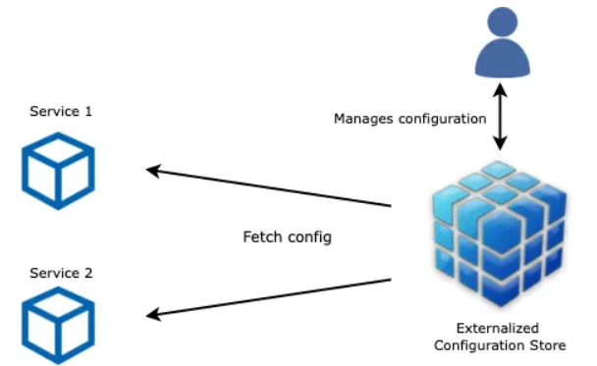
Decouple Configuration from Application Code with Spring Cloud Config
Centralized configuration is a pattern where the configuration for all services is managed in a central repository.
Decoupling configuration from services helps with easier organization and management of settings. This separation enables independent changes to configurations without the need to redeploy services.

Slide 9
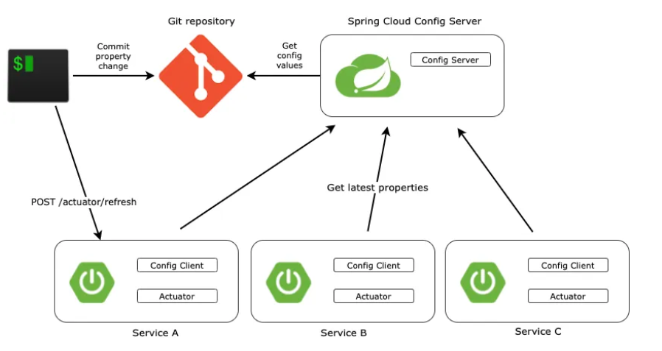
Centralized Configuration Service

Slide 10
Understanding Externalized Configuration
Externalized configuration is a pattern in software design where configuration settings are separated from the application code.
This pattern becomes increasingly essential as applications grow in complexity, requiring more configuration settings for different environments, instances, and contexts.

Slide 11
Understanding Externalized Configuration
Externalized configuration is a pattern in software design where configuration settings are separated from the application code.
This pattern becomes increasingly essential as applications grow in complexity, requiring more configuration settings for different environments, instances, and contexts.
In traditional application development, configurations are often bundled within the application, making it difficult to adapt the application to various environments (development, testing, production) without modifying the code or rebuilding the entire application.

Slide 12
Dynamic Configuration
By keeping the configuration separate and in an external repository, you can change the configuration of your application dynamically at runtime. When the application starts up, it queries the Spring Cloud Config Server for its configuration.
The Config Server then pulls the latest configuration from the external repository and serves it to the application.

Slide 13
Separation of Configuration
The separation of configuration from the application code allows developers and operations teams to manage and modify configurations independently, providing more flexibility and control over the application’s behavior in different environments.
This approach also streamlines the process of migrating applications through different environments during the development lifecycle.
Configuration for each environment can be stored in the external repository, and the application can pull the appropriate configuration based on its current environment at startup.

Slide 14
Utilizing @RefreshScope for Dynamic Updates
In a microservices environment, it’s crucial to ensure that configuration changes do not require a complete system restart for the changes to take effect.
@RefreshScope in Spring Cloud provides a mechanism for this. It allows beans in the Spring ApplicationContext to be re-initialized on demand to pick up refreshed or updated configuration values from an external source like a Git repository managed by Spring Cloud Config Server.
When you annotate a Spring @Bean with @RefreshScope, the bean gets special treatment. The @RefreshScope annotation marks the bean to be refreshed on a configuration change.

Slide 15

Lab: Working with Spring Cloud Configuration
Lab Guide:
https://spring.io/guides/gs/centralized-configuration

